Slide 1
Symbolic execution with reasoning tool Z3 (z3 topic-2)
Gunaqin zhang
Program Analysis Group
University of Technology Sydney (UTS)
June 12, 2020

Slide 2
Presentation structure
Symbolic execution
Example
Z3
Example
challanges

Slide 3
Introduction
Static analysis
Dynamic analysis
Program analysis
“Is our code correct?”
Symbolic Execution:
Briefly called symbex, is a means to determine what inputs causes each path of the program to be executed in the actual program runs using the symbolic values unlike the concrete values.

Slide 4
Introduction
Current static analysis:
Ideal tools / code analysis / no execution or compiling all
All possible paths with data-driven analysis tools.
Why is symbolic execution?
Some bugs missed …
Source codes embedded with obfuscation
Rare features
Simple for testers and developers.

Slide 5
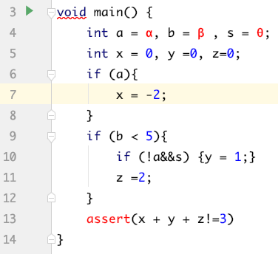

Symbolic execution Demo
x = 0, y =0, z =0
α
X = -2
β＜5
Β < 5
﹣α ∧θ
-α∧(β≥5)
α∧(β≥5)
Y=1
Z=2
Z=2
Z=2
α∧(β<5)
-α∧(β<5)∧θ
-α∧(β<5)∧-θ
α->Ture ; x =-2 |  | α->False

Slide 6
Symbolic execution Demo
x = 0, y =0, z =0
α
X = -2
β＜5
Β < 5
﹣α ∧θ
-α∧(β≥5)
α∧(β≥5)
Y=1
Z=2
Z=2
Z=2
α∧(β<5)
-α∧(β<5)∧θ
-α∧(β<5)∧-θ
α->Ture ; x =-2 |  | α->False
β < 5 -> True | β < 5 -> False

Slide 7
Symbolic execution Demo
x = 0, y =0, z =0
α
X = -2
β＜5
Β < 5
﹣α ∧θ
-α∧(β≥5)
α∧(β≥5)
Y=1
Z=2
Z=2
Z=2
α∧(β<5)
-α∧(β<5)∧θ
-α∧(β<5)∧-θ
α->Ture ; x =-2 |  | α->False
β < 5 -> True | β < 5 -> False
z = 2 | α∧(β≥5)

Slide 8
Symbolic execution Demo
x = 0, y =0, z =0
α
X = -2
β＜5
Β < 5
﹣α ∧θ
-α∧(β≥5)
α∧(β≥5)
Y=1
Z=2
Z=2
Z=2
α∧(β<5)
-α∧(β<5)∧θ
-α∧(β<5)∧-θ
α->Ture ; x =-2 |  | α->False
β < 5 -> True | β < 5 -> False
z = 2 | α∧(β≥5)
α∧(β<5)

Slide 9
Symbolic execution Demo
x = 0, y =0, z =0
α
X = -2
β＜5
Β < 5
﹣α ∧θ
-α∧(β≥5)
α∧(β≥5)
Y=1
Z=2
Z=2
Z=2
α∧(β<5)
-α∧(β<5)∧θ
-α∧(β<5)∧-θ
α->Ture ; x =-2 |  | α->False
β < 5 -> True | β < 5 -> False | β < 5 -> True |  | β < 5 -> False
z = 2 | α∧(β≥5)
α∧(β<5)

Slide 10
Symbolic execution Demo
x = 0, y =0, z =0
α
X = -2
β＜5
Β < 5
﹣α ∧θ
-α∧(β≥5)
α∧(β≥5)
Y=1
Z=2
Z=2
Z=2
α∧(β<5)
-α∧(β<5)∧θ
-α∧(β<5)∧-θ
α->Ture ; x =-2 |  | α->False
β < 5 -> True | β < 5 -> False | β < 5 -> True |  | β < 5 -> False
z = 2 | α∧(β≥5) | ﹣α ∧θ -> True | ﹣α ∧θ -> False | -α∧(β≥5)
α∧(β<5)

Slide 11
Symbolic execution Demo
x = 0, y =0, z =0
α
X = -2
β＜5
Β < 5
﹣α ∧θ
-α∧(β≥5)
α∧(β≥5)
Y=1
Z=2
Z=2
Z=2
α∧(β<5)
-α∧(β<5)∧θ
-α∧(β<5)∧-θ
α->Ture ; x =-2 |  | α->False
β < 5 -> True | β < 5 -> False | β < 5 -> True |  | β < 5 -> False
z = 2 | α∧(β≥5) | ﹣α ∧θ -> True | ﹣α ∧θ -> False | -α∧(β≥5)
α∧(β<5) |  | Y=1 ; z=2 | Z=2

Slide 12
Symbolic execution Demo
x = 0, y =0, z =0
α
X = -2
β＜5
Β < 5
﹣α ∧θ
-α∧(β≥5)
α∧(β≥5)
Y=1
Z=2
Z=2
Z=2
α∧(β<5)
-α∧(β<5)∧θ
-α∧(β<5)∧-θ
Path conditions → constraints
α->Ture ; x =-2 |  | α->False
β < 5 -> True | β < 5 -> False | β < 5 -> True |  | β < 5 -> False
z = 2 | α∧(β≥5) | ﹣α ∧θ -> True | ﹣α ∧θ -> False | -α∧(β≥5)
α∧(β<5) |  | Y=1 ; z=2 | Z=2
 |  | -α∧(β<5)∧θ | -α∧(β<5)∧-θ

Slide 13
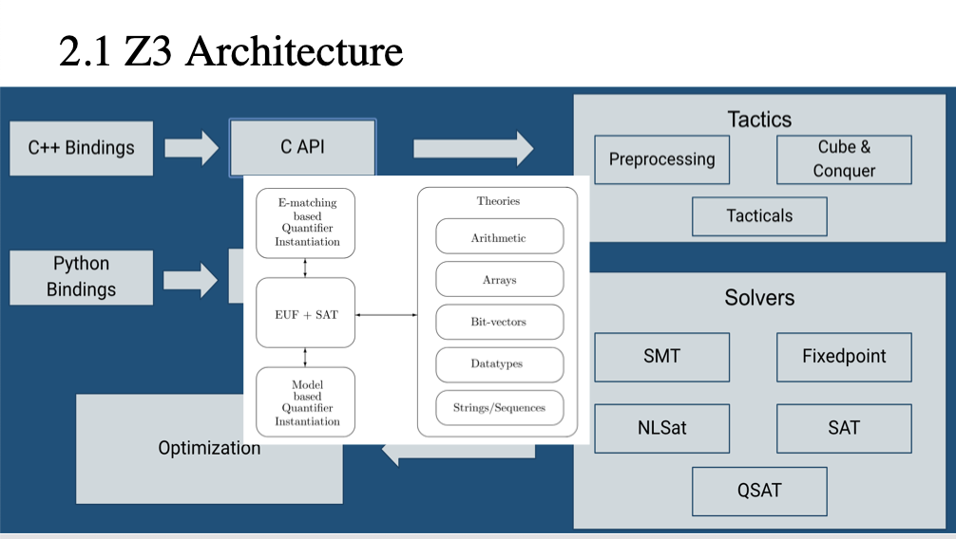
Constrains and constrain solvers
A set of the objects that satisfied a certain constrains or limited conditions.
Solvers like SAT or SMT
Solver engine :

Slide 14
Z3 Theorem Prover
Precise reasoning engine
Verifcation projects
SMT solver
Arithmetic calculations ( + – x ÷ √ ㏒ ㏑ ∑ ≤ ≥ min max)
1: Z3 solve the math formulas
2: Z3 solve the logical sequences

Slide 15
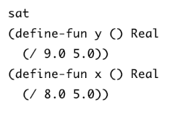
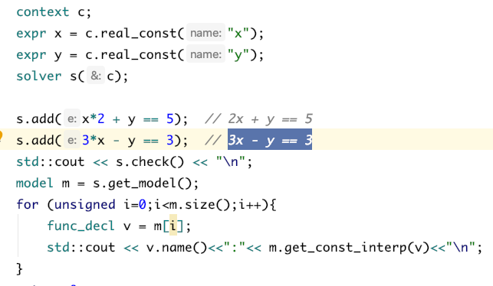
Z3 solve the math problem
formular 1:
2x + y == 5
3x - y == 3
Output：
Context -- to store the elements
Solver -- the stack to solve problem
Model(set) – returned from slover result

Slide 16
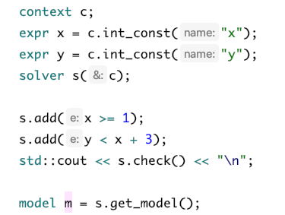
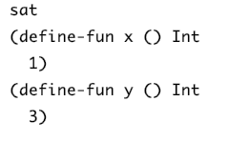
formula 2:
Constraints for vals:
X>=1
Y <x+3
Output：
---> (5)

Slide 17
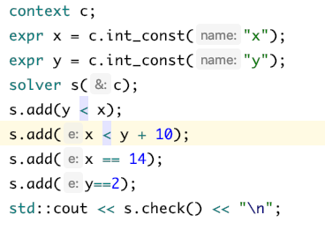
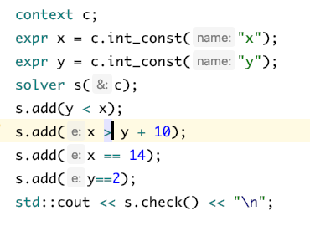
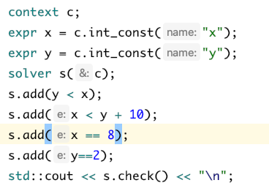
Logical problem solving in symbolic execution way (using concrete inputs as an example)
Path1 : constraints : x > y && x > y+10
constraints
If (x > y){
if (x > y+10){
assert 1}
else:
assert 2
}
else:
assert 3
Concrete test
unsat
sat
Path 2 : constraints : x > y && x < y+10
sat
Path 3 : constraints : x< y

Slide 18
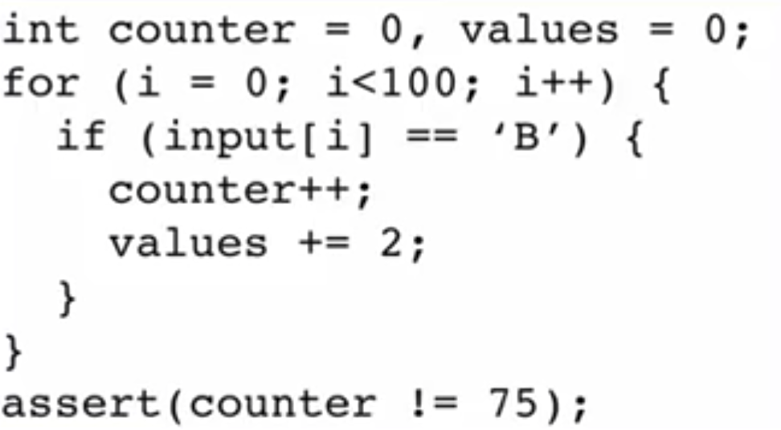
Challenges
Path based limitations(death loops)
Enter or not?
2**100 sum of the paths
As the bug

